Slide 1

Fast track couriers

Slide 2

REQUIREMENTS FOR CHANGE
Implementing the right PDA by using GPS in productivity truck ship operation.
Implement one on one truck policy using typical lift gates.
efficient use of resources to meet market needs.
The number of work results for training purposes.
Explain more the detail about change to the driver and keep in mind on requirements for drivers

Slide 3

ORGANIZATIONAL STRATEGIC PLAN GOALS
The company changes its technology by including GPS systems and PDA devices.
Establishing training programs to achieve strategic goals.
To improve the performance of drivers, To build up trust, provide training about automated liftgate.
To increase the number of their trucks to reduce delivery time

Slide 4
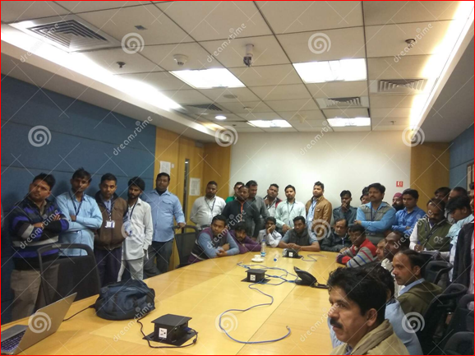
ORGANISATION PERFORMANCES
PEOPLE
Drivers were hesitant about the company because the company didn’t trust them.
Drivers neglect to participate in any training programs
The company has to change to two drivers per truck for their requirement.
TECHNOLOGY
Implementing GPS & PDA to records the progress of a job.

Slide 5
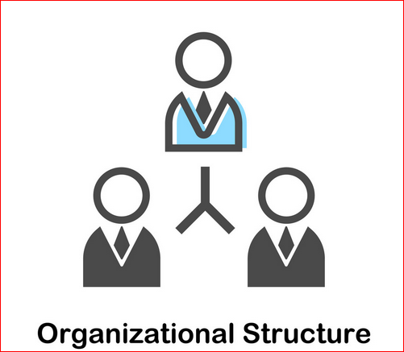
STRUCTRUE
-General manager
-Chief financial officer
-Accountant
-Office team manager
-Officer team members
-Drivers

Slide 6
EXTERNAL TRENDS
COST
-For GPS, -To increase the number of their trucks
WAGES
-Average driver wages in NSW are usually higher than in Fast Track. Chance of poor results from drivers.
COMPETITOR
-Other competitors offer a low rate of price or fastest service or even Sunday services.
WEATHER
-Bad weather such as a storm, flood, the driver can’t delivery on time and also it can lead to the death of the supplier.

Slide 7
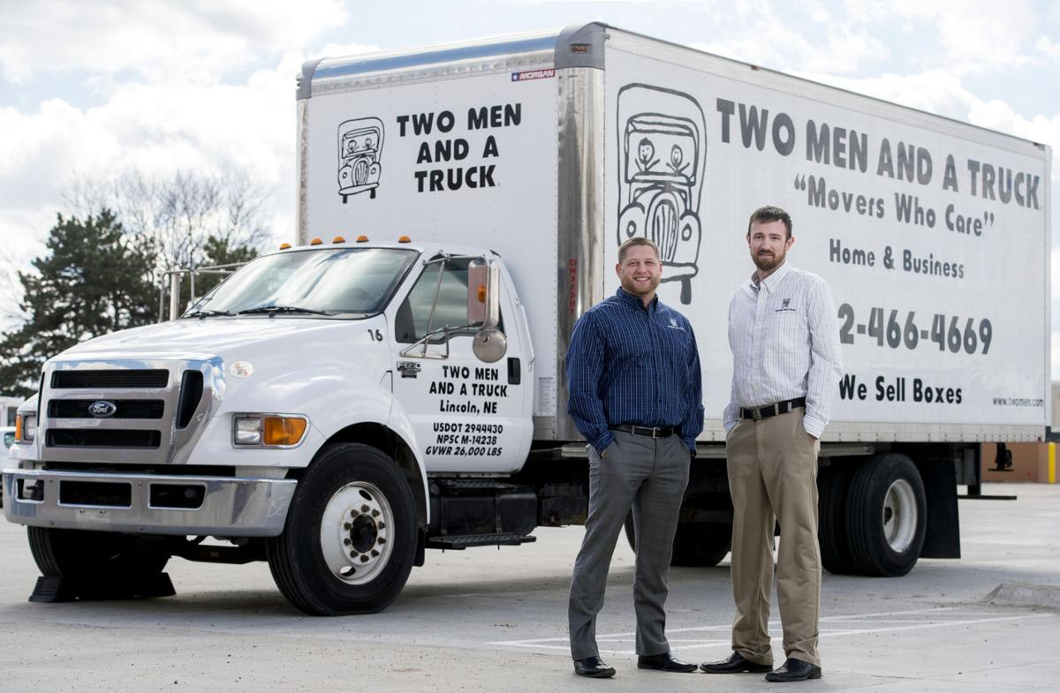
Major Operational Change Requirement
Identify changes due to performance gaps
Team of Two-man driver for heavy packaging, only one driver per truck when no heavy lifting is required.
The drivers were happy with their work environment.
Identify changes due to business opportunities
Buy more trucks increase efficiency service and expand business opportunities.

Slide 8
Identify changes due to threats
-Drivers don’t like to participate in any training programs.
-Drivers had threatening strike action and having the union for changing to two men drivers per truck.
Identity charges due to management decisions
-Management decision change to two-man driver team, the drivers happy with this changing
-Management tried to organize organisational activities, the drivers don’t like to participate.

Slide 9

SPECIALISTS
Consultant specialist
To identify and solve the problem.
Company still have to focus on day-to-day operation, they don’t have enough staff to run a new project.
The consultant specialist will bring expertise and specialized skill to handle these situations.
Work Safe Victoria
The Victorian Work cover Authority will organize come to the workplace, help identify safety issues, and provide useful advice on addressing the issues.

Slide 10
REFERENCES
1.4 identify major operational change requirements due to performance gaps, business opportunities or threats, or management decisions. (n.d.). Retrieved from https://academy-of entrepreneurs.teachable.com/courses/bsbinn601- leadership/lectures/4537193
Change management (OD) vs. Change management (Operational). (n.d.). Retrieved from https://smallbusiness.chron.com/change-management-od-vs-change-management-
operational-15706.html

